Slide 1
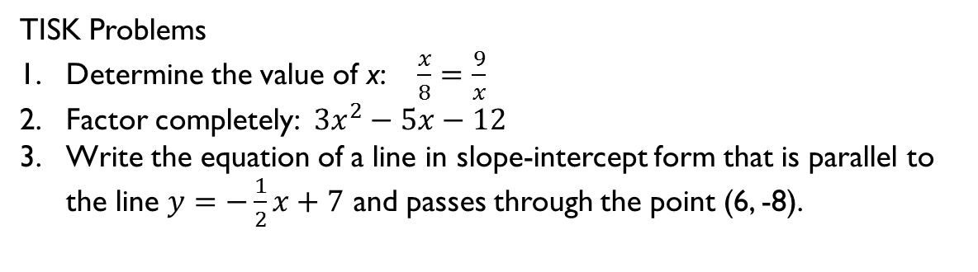
Wednesday, January 9, 2013
Agenda:
TISK & 2 MM
Lesson 7-2: Exploring Similar Polygons
Homework: Work on Ch 7 Packet 1 §7-2 problems
TISK Problems
Determine the value of x: $\frac{x}{8}=\frac{9}{x}$
Factor completely: $3x^{2}−5x−12$
Write the equation of a line in slope-intercept form that is parallel to the line $y=−\frac{1}{2}x+7$ and passes through the point (6, -8).
Notes:
Mental Math
1.) Start with four more than twice the number of eggs in a dozen. Divide by 7. Multiply by the number of years in a decade. Subtract half of 30. Take the positive square root. (5)
2.) Start with 8 less than triple the number of nickels in a quarter. Square it. Add 90. Subtract 58. Take the negative square root. (-9)

Slide 2
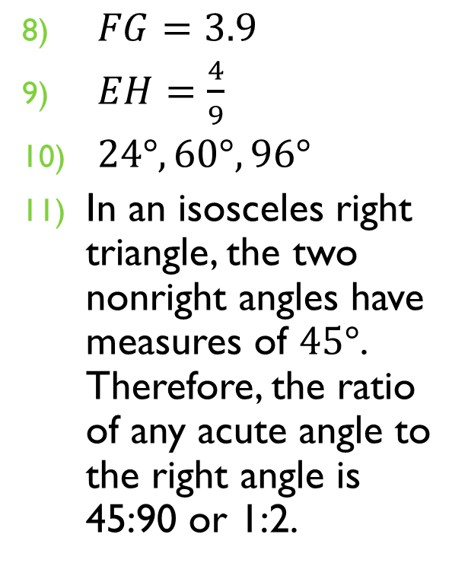

Homework Check
$\frac{2}{3}$
$\frac{4}{5}$
$\frac{76}{89}$
$a=1.295$
$n=−\frac{1}{7}$
$a=−11$
$x=−1$
$FG=3.9$
$EH=\frac{4}{9}$
$24°, 60°, 96°$
In an isosceles right triangle, the two nonright angles have measures of $45°$. Therefore, the ratio of any acute angle to the right angle is 45:90 or 1:2.

Slide 3
§7.2 Similar Polygons
Similar polygons have the same shape, but not the same size.
Definition:
Two polygons are similar if and only if their corresponding angles are congruent and their corresponding sides are proportional.
The ~ symbol is used to mean “is similar to”.

Slide 4
Writing Similarity Statements
Pentagon EJHGF ~ pentagon VWXTU. List the pairs of congruent angles, then write the ratios of corresponding sides in a statement of proportionality.
Congruent Angles
Side Ratios

Slide 5
Comparing Similar Polygons
Decide if the figures are similar. If they are similar, write a similarity statement.
6
9
The congruent angles seem to lead us to say yes, but to be sure, the sides have to be proportional…
4
6
15
10
8
12
Similarity Statement:
LMNK ~ BCDA

Slide 6
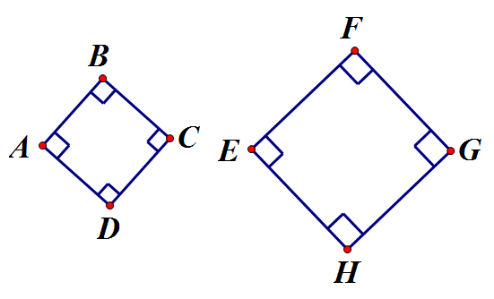
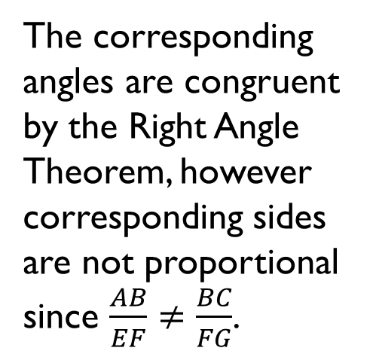
Comparing Similar Polygons
Decide if the figures are similar. If they are, write a similarity statement.
The corresponding angles are congruent by the Right Angle Theorem, however corresponding sides are not proportional since $\frac{AB}{EF}≠\frac{BC}{FG}$.
10
7.5
5
5

Slide 7
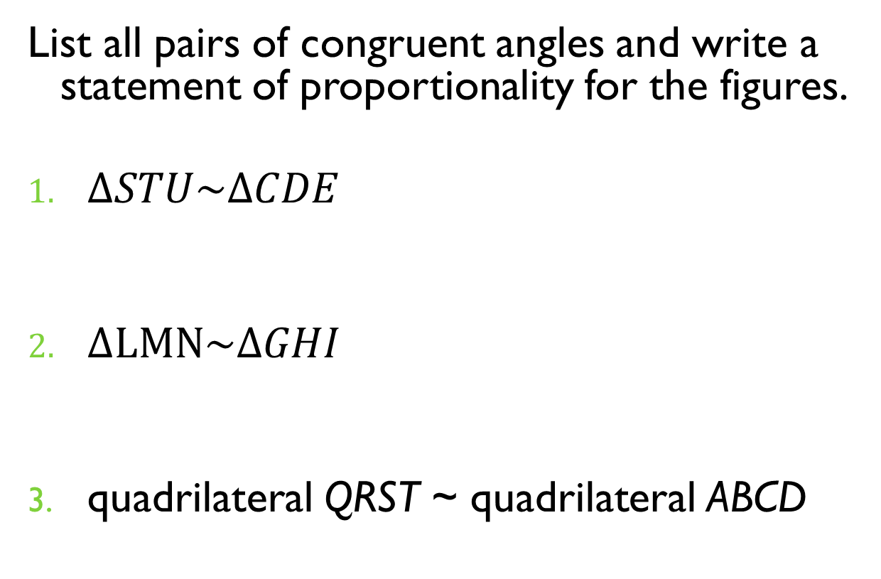
You try it.
List all pairs of congruent angles and write a statement of proportionality for the figures.
$ΔSTU\sim ΔCDE$
$ΔLMN\sim ΔGHI$
quadrilateral QRST ~ quadrilateral ABCD

Slide 8
Use Similar Polygons
The quadrilateral BCDE is similar to quadrilateral HFGK. Find the value of z.
10
z
6
22
15

Slide 9
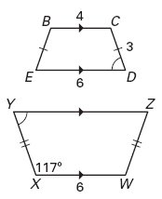

You try it.
Quadrilateral BCDE ~ quadrilateral WXYZ .
Find XY. Find $m∠D$.

Slide 10

Illustrating statements with pictures.
For each statement, decide if it is always true, sometimes true, or never true. Draw figures to support your answer.
A square is similar to a rectangle.
Sometimes.
Square
Rectangle
Square
Rectangle
~
$$≁$$

Slide 11
Illustrating statements with pictures.
For each statement, decide if it is always true, sometimes true, or never true. Draw figures to support your answer.
A triangle is similar to a kite.
Never.
The angles can’t match up.

